Slide 1
Chatham County Health and Air Quality
Mapping Urban Heat to Identify Priority Mitigation Areas in Chatham County, Georgia
Patrick O'Shea, Austin Lavorata, Ian Maywar, Sydney Pearce (Analytical Mechanics Associates)
Virginia – Langley | Spring 2025
Notes:
Welcome! This term, the virtual team at the Langley Research Center conducted a feasibility study assessing the use of NASA Earth Observations to enhance authority response to Urban Heat in Chatham County, Georgia.

Slide 2




The Team
Patrick O'Shea
Project Lead
Austin Lavorata
Team Member
Ian Maywar
Team Member
Sydney Pearce
Team Member
Chatham County Health & Air Quality
Notes:
(Team introduces themselves)

Slide 3
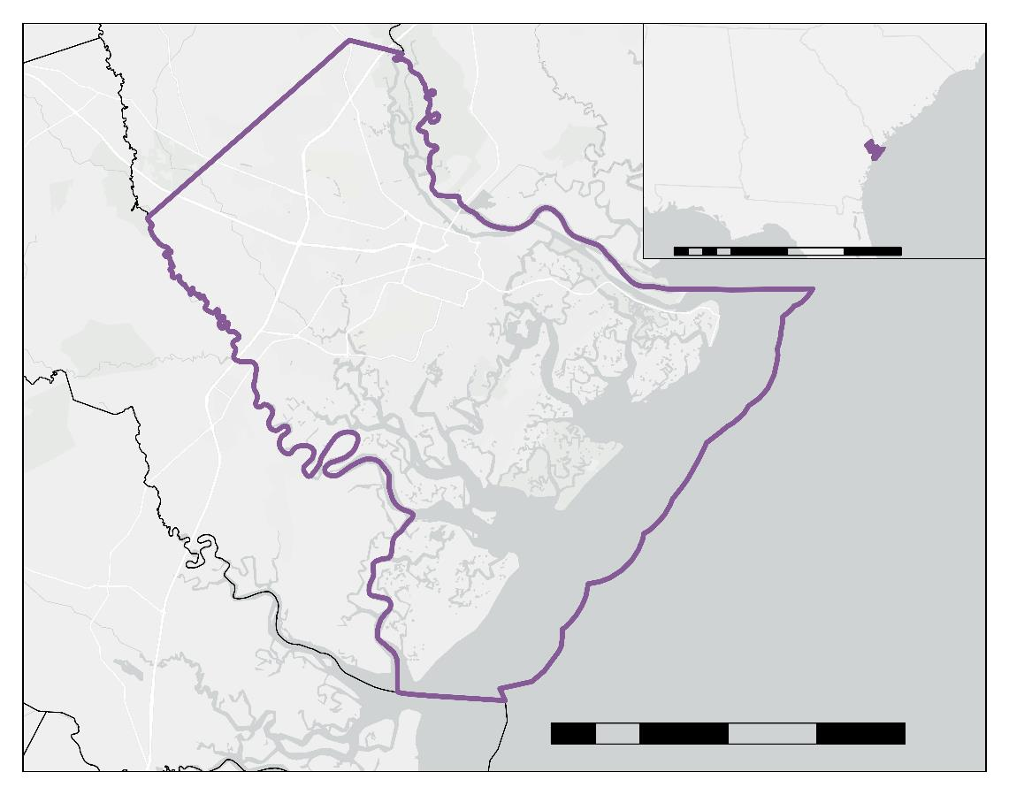
Study Area and Period
Effingham County
South Carolina
Port
Wentworth
Alabama
Georgia
Bloomingdale
Study Area​: Chatham County, GA
Population: ~300,000 (2023)
Area: 630 mi²
Pooler
Garden City
100
200
300
400
0
50
mi
Savannah
Thunderbolt
Tybee Island
Bryan County
Vernonburg
Chatham County
Study Period​: 2014 – 2024​
Growing Period: May – October
N
Liberty County
Chatham County
Communities
0
5
10
15
20
mi
Basemap Credits: Esri, HERE, Garmin, INCREMENT P, © OpenStreetMap contributors, and the GIS User Community
Chatham County Health & Air Quality
Notes:
Our study area is Chatham County, Georgia, Located on the northeast coast of the state and home to Savannah: Georgia's 4th largest city. The county is 632 square miles in size, with nearly a third of it being water, is home to nearly 300,000 people, and makes up 6% of the country's economy.
For our study period, we focused on summers between 2014 and 2024. We looked at this time period since it constitutes a temporal gap in studies previously conducted through the county, as well as corresponds to a period of known development throughout several communities.
Basemap citation: Map Credits: Esri, TomTom, Garmin, FAO, NOAA, USGS

Slide 4


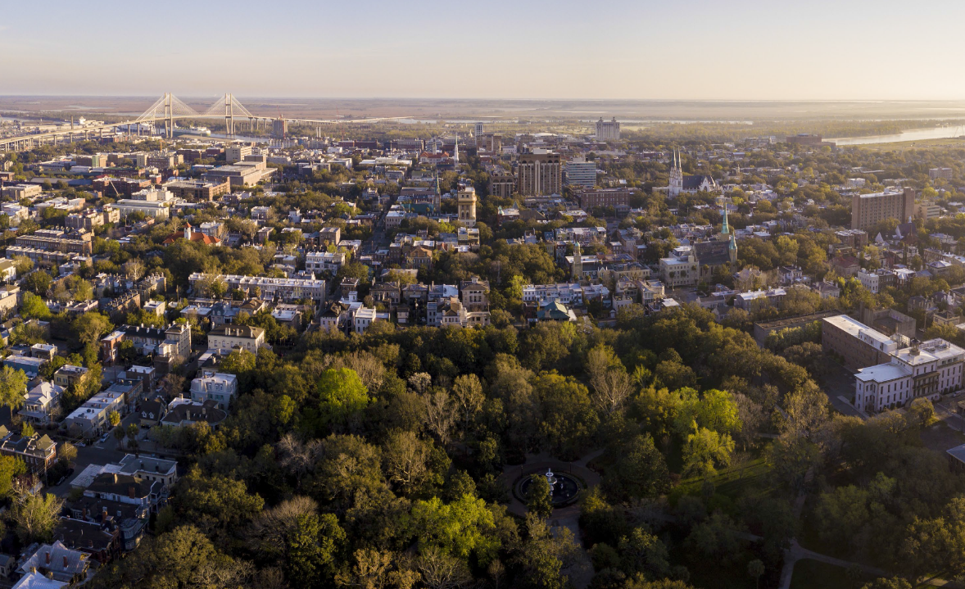


Background: Urban Heat Islands in Chatham County
Between 1992 and 2011, areas that underwent land cover change saw temperature increases of up to 27 °F (Fragomeni, 2019)
Urban Heat Island (UHI) effect can be mitigated through tree planting
Chatham County lost 3 football fields of tree canopy per day between 1999 and 2014 (Savannah Tree Foundation, 2015)
Image Credit: Chatham County
Chatham County Health & Air Quality
Notes:
The Urban Heat Island (UHI) effect is a phenomenon where urban areas experience higher temperatures relative to nearby non-urban areas. The phenomenon is caused by high concentrations of impervious surfaces in the urban environment, restricted airflow between buildings, and emissions that create heat domes.
Previous research has been done to look at urban heat trends in Chatham County. One study that looked at land surface temperature trends between 1991 and 2011 found that areas in the county that were developed experienced an temperature increases of up to 27 degrees F.
Research has found that an effective way to reduce UHI intensity is to increase urban tree canopy cover through planting trees. Trees cool the urban environment by absorbing solar radiation, which both provides cooling shade, and local heat-absorbing humidity through natural evapotranspiration.
A urban tree canopy assessment within the county found that Chatham county had lost 21,437 acres of canopy between 1999 and 2014, equivalent to 3 football fields of canopy a day, and that the county was projected to lose another 36% of it's tree canopy by 2050. The decline in tree canopy throughout the county has aligned with the increase in the county's population, which increased by around 30% (232,048 - 303,655) between 2000 and 2023.
Just some background on UHI and the county
The Urban Heat Island (UHI) effect is a phenomenon where urban areas experience higher temperatures relative to nearby non-urban areas.
It's caused by high concentrations of impervious surfaces, restricted airflow between buildings, and emissions that create heat domes.
A previous study has shown that between 1991 and 2011, there was an increase in land surface temperature of up to 27 degrees F in Chatham County, GA.
UHI can be mitigated through tree planting.
Trees cool the urban environment by absorbing solar radiation, which both provides cooling shade, and local heat-absorbing humidity through natural evapotranspiration.
A urban tree canopy assessment within the county found that Chatham lost around 3 football fields of tree canopy cover per day between 1999 and 2014
A big concern for UHI
Extra notes
Chatham lost 21,437 acres of canopy between 1999 and 2014, equivalent to 3 football fields of canopy a day, and that the county was projected to lose another 36% of it's tree canopy by 2050. The decline in tree canopy throughout the county has aligned with the increase in the county's population, which increased by around 30% (232,048 - 303,655) between 2000 and 2023.
--------Image Information Below--------
[Right]
Image Credit: Chatham County
Image Source: Share by and used with permission by Chatham County

Slide 5
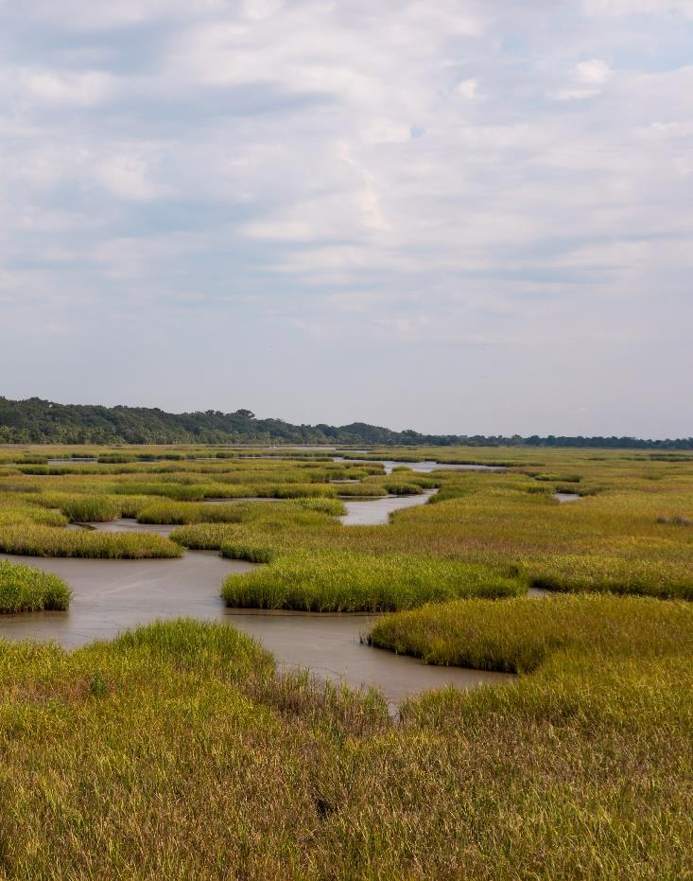



Partners
Local Government of Chatham County​
Manage and maintain the health of communities within Chatham County
Image credit: Chatham County​
Chatham County Health & Air Quality
Notes:
For this project, we partnered with the local government of Chatham County. Chatham County manages and works to maintain and improve the health of the communities within Chatham County.
The county has expressed that urban heat island effects are becoming more severe in the region and are looking for possible solutions on how best to mitigate them.
Speaker Notes
We partnered with the local government of Chatham County. They work to maintain and improve the health of the communities within their jurisdiction
The county has expressed that UHI effects are becoming more severe in the region and are looking for possible solutions on how best to mitigate them.
--------Image Information Below--------
[Right]
Image Credit: Chatham County
Image Source: Share by and used with permission by Chatham County

Slide 6





Community Concerns
Urban Development
Tree Canopy Loss
Increased Heat Impacts
Population Growth
Public Safety
Chatham County Health & Air Quality
Notes:
Chatham county is concerned about the impact of industrialization (urban development) and population growth on tree canopy cover and in turn increased heat impacts in the county. They are especially concerned about the impact of urban heat on vulnerable populations as it pertains to public safety as well as heat mortality / morbidity.
They expect to lose another 36% of their tree canopy by 2050. The decline in tree canopy throughout the county has aligned with the increase in the county's population, which increased by around 30% (232,048 - 303,655) between 2000 and 2023.
--------Image Information Below--------
Icons provided by Microsoft Office.

Slide 7
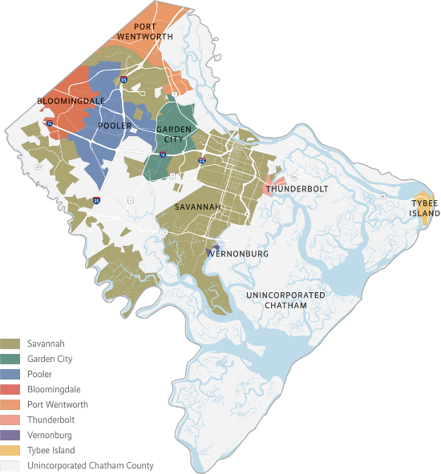
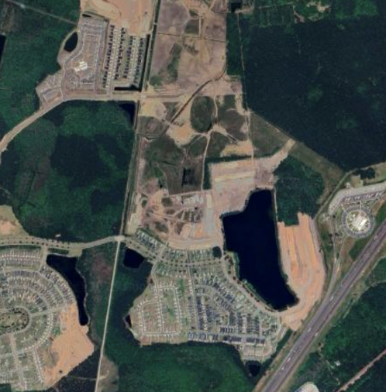
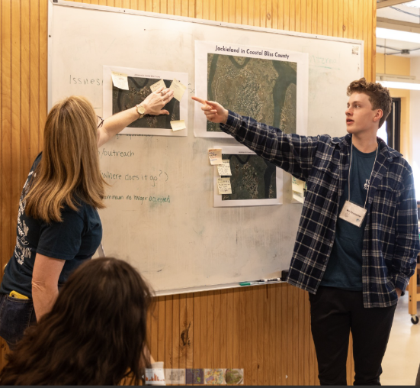
Project Objectives
Explore Environmental Changes Over Time
Identify Areas At Risk to Urban Heat Impacts
Inform Mitigation Strategies ​
*map of municipalities*
Image Credit: Google Earth
Image Credit: Chatham County
Image Credit: Chatham County
Chatham County Health & Air Quality
Notes:
For our project, the objectives included:
1. Exploring how environmental factors such as Land Surface Temperature/urban heat, vegetation health/ndvi, canopy cover, albedo, and evapotranspiration change over time using earth observations.
2. Identifying areas that are most at risk for significant urban heat impacts by mapping areas where areas experience significant increases in urban heat along with decreases in vegetation health and canopy cover occur. We will also look to understand the impacts of these changes on the people of Chatham county by overlaying environmental risk with social vulnerability, as well as map areas that have limited capacity to mitigate against heat.
3. Creating a set of deliverables to help aid Chatham county in informing their heat mitigation strategies such as where to plant trees and set up cooling stations.
Investigate changes in Land Surface Temperature (LST) over time
Examine NAIP and Landsat imagery to assess canopy cover and vegetation health
Analyze Community Resilience Estimate (CRE) data for areas of high heat risk
----------Image Information Below----------
[Left]
Image Credit: Google Earth
Image Source: https://earth.google.com
Map Data: ©2023 Google & Airbus
[Middle]
Image Credit: Chatham County
Image Source: Share by and used with permission by Chatham County
[Right]
Image Credit: Chatham County
Image Source: Share by and used with permission by Chatham County
Provide urban heat and heat vulnerability maps to partners
Present case study to display effects of urban heat on at-risk communities

Slide 8
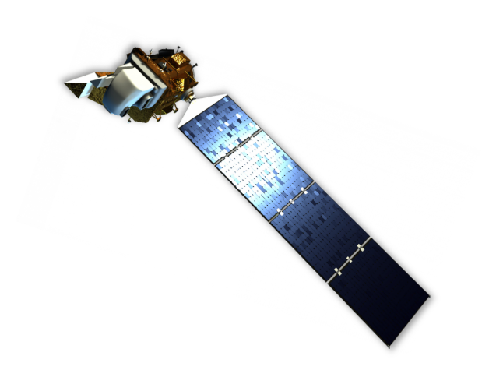
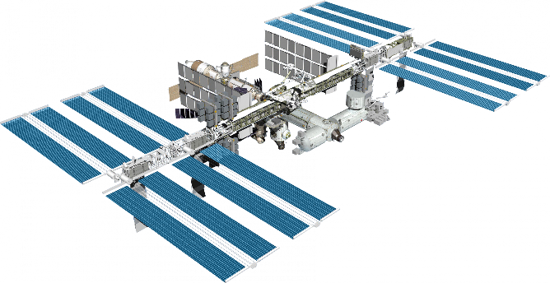
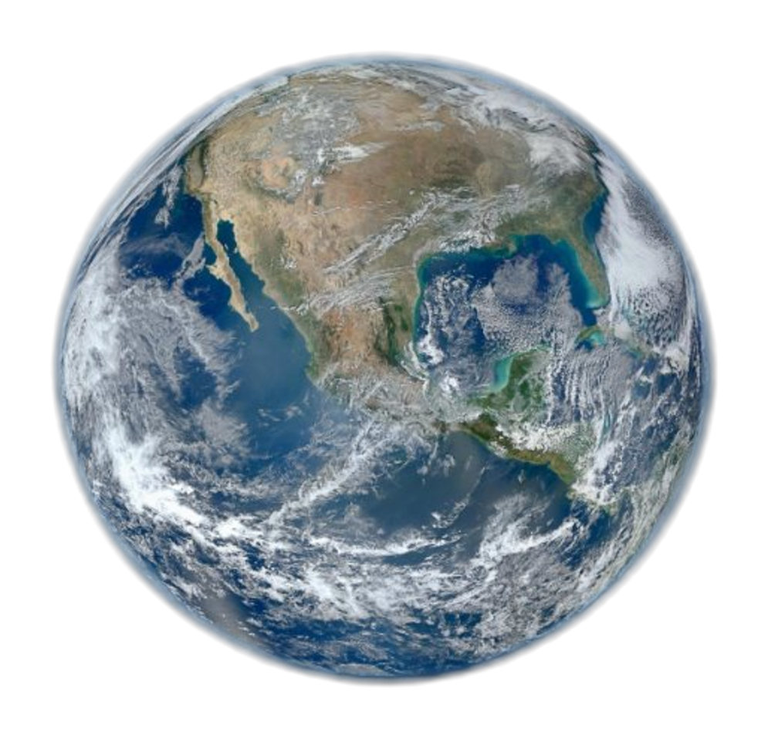
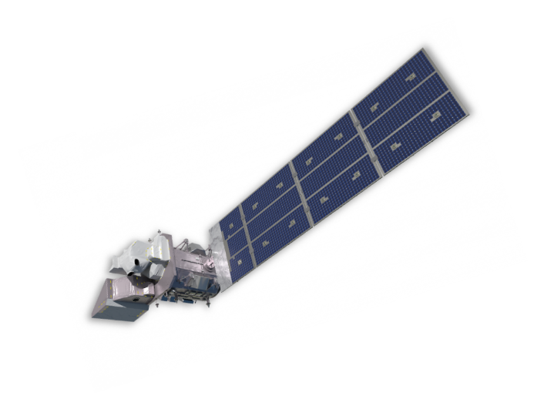
Earth Observations
LANDSAT 8 OLI, TIRS
ISS
ECOSTRESS
LANDSAT 9
OLI-2, TIRS-2
Image Credits: NASA
Chatham County Health & Air Quality
Notes:
We used Earth observations collected by Landsat 8 Operational Land Imager, Landsat 9 OLI-2, Landsat 8 Thermal Infrared Sensor, Landsat 9 TIRS-2, and ISS ECOSTRESS. The Landsat 8-9 datasets provided 30-m resolution optical imagery and 100-m resolution infrared data. ISS ECOSTRESS provided 70-m evapotranspiration and nighttime urban heat data.
----------Image Information Below----------
[Landsat 8]
Image Credit: NASA
Image Source: https://science.nasa.gov/multimedia/spacecraft-icons/%e2%80%8b
[Landsat 9]
Image Credit: NASA
Image Source: https://science.nasa.gov/multimedia/spacecraft-icons/%e2%80%8b
[ISS]
Image Credit: NASA
Image Source: https://science.nasa.gov/wp-content/uploads/2023/05/iss.png
[Earth Image]
Image Credit: NASA
Image Source: https://images.nasa.gov/details/PIA18033

Slide 9


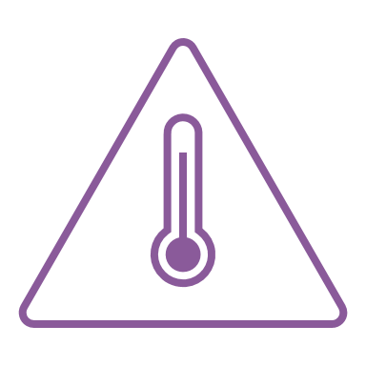
Methodology: Heat Vulnerability Factors
Earth Observations
Analysis
Outputs
NLCD Land Cover Imagery
Change Over Time Maps
Canopy Cover
Environmental Risk
Landsat 8 OLI & Landsat 9 OLI-2 Imagery
Vegetation Health
Landsat 8 TIRS & 9 TIRS-2 Imagery
Heat Vulnerability Index
Urban Heat
Census Heat Community Resilience Estimate
Social Vulnerability
Chatham County Health & Air Quality
Notes:
To understand urban heat trends in Chatham County, our team gathered Landsat 8 and 9 TIRS-2 to investigate urban heat using land surface temperature (LST) and vegetation healthy using normalized difference vegetation index (NDVI). This was done using a python script that accessed the Planetary Computer Landsat Collection 2 Level-2 PySTAC catalog.
To filter the PySTAC images, we removed images that had over 5% null values and had greater than 30% cloud cover, as well as applied a cloud masking filter. With our images filtered, we extracted the TIRS_B10 band to perform the urban heat calculation along with the red and near-infrared bands to perform the NDVI calculation. We compiled the resulting urban heat layers to create a median composite images and NDVI layers to create the 90% value composite images for each year. We then exported these as geotiffs for visualizing in ArcGIS Pro.
For Analyses, we used ArcGIS Pro to visualize how urban heat and NDVI has changed from 2014 to 2024. Additionally, we used a Python script to perform Pearson and Spearman correlations between NDVI and urban heat, specifically in Pooler and Port Wentworth.
Tree canopy cover represents a major variable relative to urban areas and heat (McDonald et al, 2021). We sourced Landsat 8 OLI imagery data from the United States Geological Survey via the EarthExplorer portal. We also sourced NAIP imagery from the United States Department of Agriculture, through the USDA NAIP data portal. We additionally acquired NLCD Land Cover data to use for the classification of the tree canopy in Chatham County. Supervised classification was done using Landsat 8 OLI imagery and NLCD land cover data. The tree canopy cover layer was isolated for each year being examined (2015, 2017, 2019, 2021, 2023). These Tree canopy cover layers were then combined to create a time difference map to show the change in canopy cover percentage between 2015 and 2023 within Chatham County.
The census community resilience estimate (CRE) for heat is a measure of social vulnerability as it relates to extreme heat exposure. We obtained this data from the US census bureau, and used the variable "rate of individuals with three plus components of social vulnerability" for our analysis. After filtering our data to Chatham County, we incorporated NDVI, urban heat, and canopy cover (to be completed) data. We scored each variable from 1-3 using quantiles for an overall EVI score of 3-9 and SVI of 1-3. We used a multiplied blending mode to overlay the ERI and SVI and display the HVI bivariate plot. We used Land Cover imagery from the National Land Cover Database along with Landsat 8 and 9 satellites in order to map canopy cover. We additionally used Landsat 8 and 9 in order to map vegetation health and urban heat. These three factors make up our environmental risk index and our first end product resulting from these analyses were change over time maps.
We additionally used the census community resilience estimate (CRE) for heat, which is a measure of social vulnerability as it relates to extreme heat exposure. We obtained this data from the US census bureau, and used the variable "rate of individuals with three plus components of social vulnerability" for our analysis. After filtering our data to Chatham County, we incorporated NDVI, urban heat, and canopy cover data. We scored each variable from 1-3 and displayed the findings in a HVI bivariate plot.

Slide 10
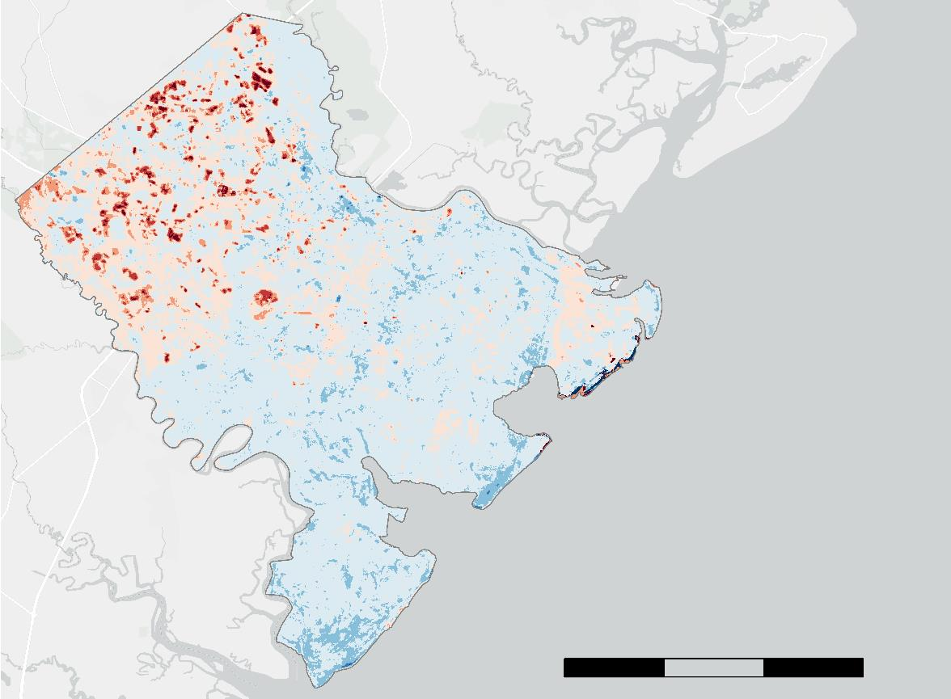
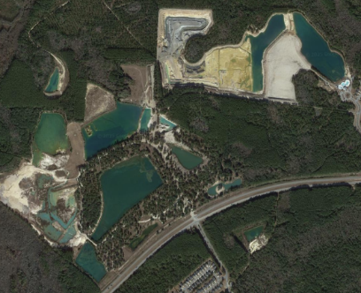
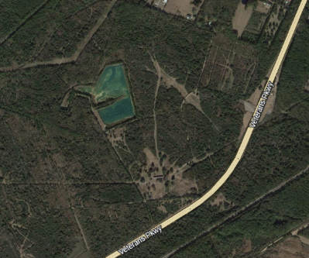
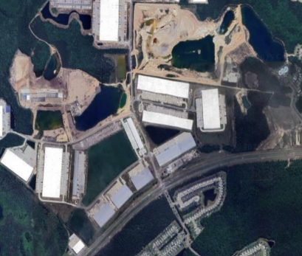
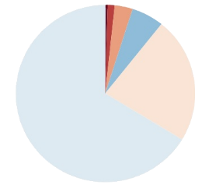
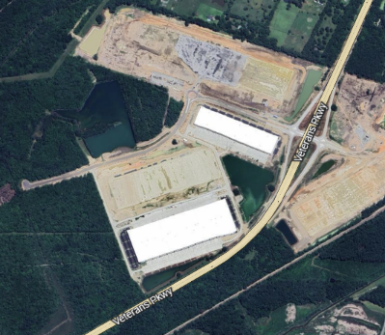
Results: Urban Heat
Basemap Credits: Esri, HERE, Garmin, INCREMENT P, © OpenStreetMap contributors, and the GIS User Community
2014
7,332 Acres (~1.8 %) saw significant
increases between 2014 and 2024
2014
Image Credit: Google Earth
Image Credit: Google Earth
Median Urban
Heat Change (°F)
2024
2024
< -15° (0.0%)
-15° - -10° (0.1%)
-10° - -5° (5.8%)
-5° - 0° (66.3%)
0° - 5° (22.9%)
5° - 10° (3.2%)
10° - 15° (1.3%)
N
>15° (0.4%)
0
5
10
15 mi
Image Credit: Google Earth
Image Credit: Google Earth
Chatham County Health & Air Quality
Notes:
Using ArcGIS Pro, we took the difference between the first three years (2014-2016) and the last years (2022-2024) of median urban heat change. This range was chosen to ensure we had enough images to create our composite urban heat images. Urban heat is land surface temperature that we normalized using a reference area temperature. We chose a reference area just south west of the county that was forested during the entire study period. From this analysis, we found that:
Nearly 2/3 of the county saw a minor decrease in temperature on the scale of 0 – 5 F, while nearly another 20 percent showed a minor increase.
Areas where increases in temperature are a concentrated more towards the north west part of the county in and around pooler and port wentworth
We zoomed in a several of these areas and found that areas were significant urban heat increases occurred corresponded to areas that were developed, we present two examples here.
We performed a z-score statistical analysis to find areas where heat increases were significant (99th percentile), we found that 7,332 acres (~1.8%) of the county saw statistically significant increases in temperature during this time.
----------Image Information Below----------
[Google Earth (top left 2014)]
Image Credit: Google
Image Source: https://earth.google.com
Map Data: ©2024 Google
[Google Earth (top right 2014)]
Image Credit: Google
Image Source: https://earth.google.com
Map Data: ©2014 Google & Maxar Technologies
[Google Earth (bottom left 2024)]
Image Credit: Google
Image Source: https://earth.google.com
Map Data: ©2024 Google & Airbus
[Google Earth (bottom right 2024)]
Image Credit: Google
Image Source: https://earth.google.com
Map Data: ©2024 Google & Airbus

Slide 11
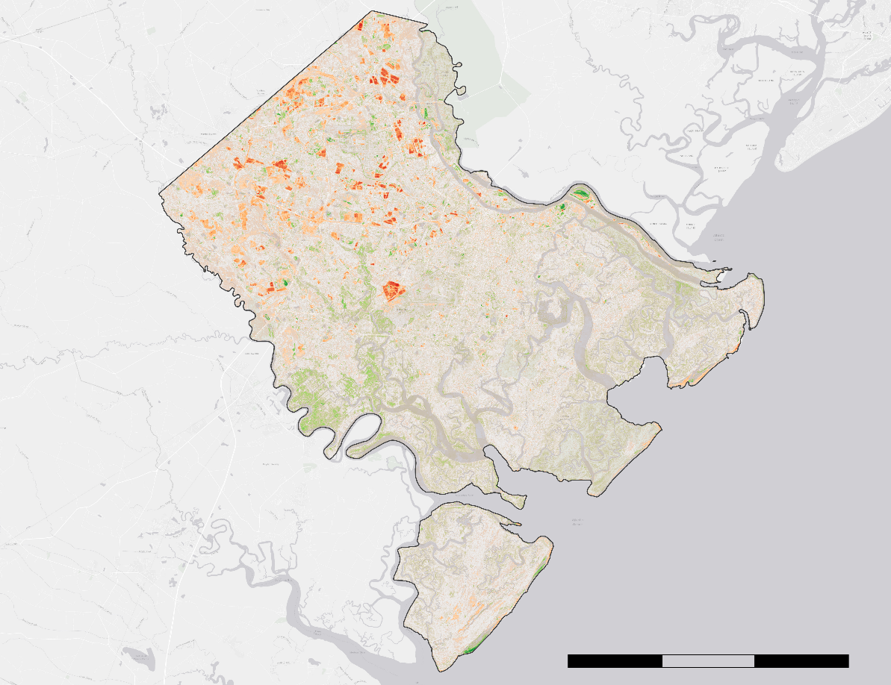


Results: Vegetation Health
NDVI Change
2014/2015 –2024
Healthy Vegetation Change
0.3 (Increase)
0
-0.5 (Decrease)
Chatham County Boundary
9,435 acres (~3%) of Chatham County saw significant decreases in vegetation health between 2014 – 2015 and 2024.
0
5
10
15 mi
Basemap Credits: Esri, HERE, Garmin, INCREMENT P, © OpenStreetMap contributors, and the GIS User Community
Chatham County Health & Air Quality
Notes:
To assess changes in vegetation health and density over our time period, we mapped NDVI change against time. In order to increase accuracy, we took the difference between 2024 NDVI and a composite of 2014 and 2015 NDVI (bc Landsat 8 and 9 for 2024, only 8 for 2014/2015).
Positive values are shown in green, representing an increase in the amount of healthy vegetation and negative values are shown in red, representing a decrease in the amount of healthy vegetation in an area.
Analysis: The north-western part of the county has experienced a loss of healthy vegetation. To assess changes in vegetation health and density over our time period, we mapped Normalized Difference Vegetation Index (NDVI), a widely used metric which assesses health and density of vegetation, and looked specifically at how NDVI has changed over time. In order to increase accuracy, we took the difference between 2024 NDVI and a composite of 2014 and 2015 NDVI (bc Landsat 8 and 9 for 2024, only 8 for 2014/2015) to ensure we had enough images per time period.
Positive values are shown in green, representing an increase in the amount of healthy vegetation and negative values are shown in red, representing a decrease in the amount of healthy vegetation in an area.
Analysis: We found that 9,435 acres experienced significant decrease in vegetation health during this time period, much of which occurred in the North-Western part of the county, as you can see on the map.
9,435 Acres (~3%) of Chatham County saw significant decreases in vegetation health between 2014-2015 and 2024

Slide 12
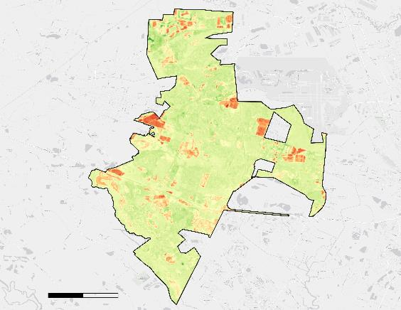

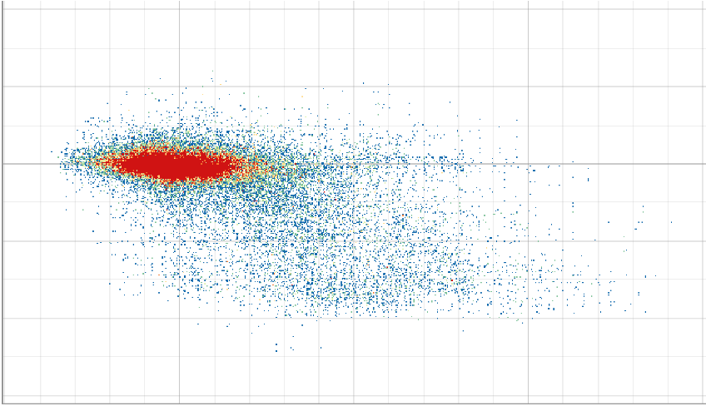
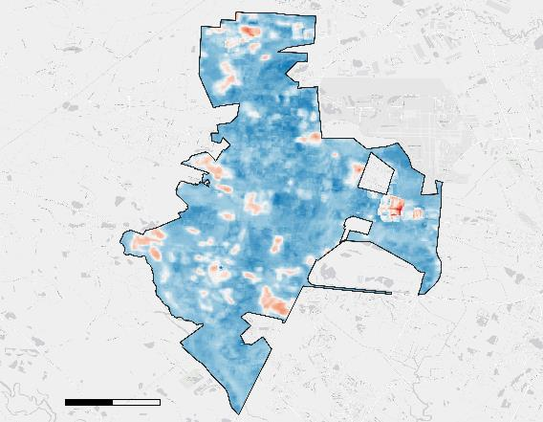

Results: Urban Heat &Vegetation Correlation – Pooler
Pooler
NDVI
2014 – 2024
NDVI
Change
0.3 (Increase)
Pooler Density Plot (Pearson r = -0.618)
0
0.4
0.2
-0.5 (Decrease)
County
Boundary
0
0
1
2 mi
NDVI Change (2014 – 2024)
Pooler
Urban Heat
2014 – 2024
Urban Heat
Change
-0.2
30 °F
-0.4
0 °F
-0.6
-10
0
10
20
30
LST Change (2014 – 2024)
-8 °F
0
1
2 mi
Municipality Boundary
Chatham County Health & Air Quality
Notes:
Based on our urban heat and vegetation change results, we wanted to look closer at how these results correlated with one another, specifically in the north-western part of the county. We evaluated the correlation between urban heat and vegetation within the communities of Pooler and Port Wentworth using a pearson correlation.
Starting with Pooler, we found a pearson correlation result of –0.618, which represent a moderate negative correlation between urban heat change and vegetation change. The means that there is a clear linkage between how urban heat and vegetation have changed in these communities (as vegetation has decreased, UH has increased), but that other factors are likely in play that are driving these trends – such as increase of impervious surfaces.

Slide 13
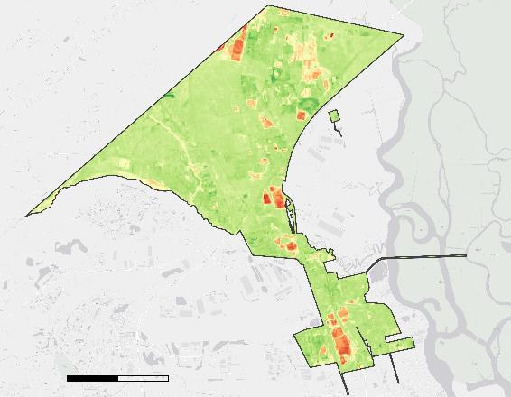
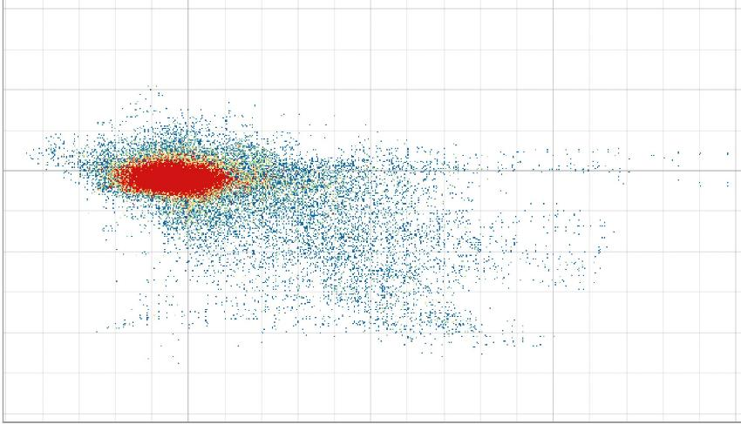
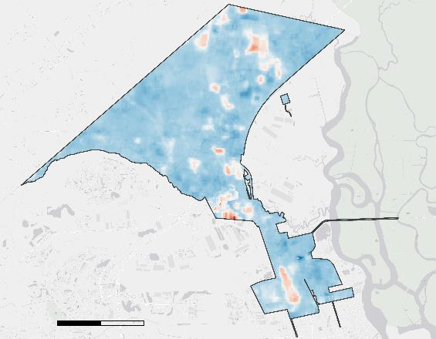
Results: Urban Heat &Vegetation Correlation – Port Wentworth
Port Wentworth
NDVI
2014 – 2024
NDVI
Change
0.3 (Increase)
Port Wentworth Density Plot (Pearson r = -0.561)
0
0.4
0.2
-0.5 (Decrease)
County
Boundary
0
0
1
2 mi
NDVI Change (2014 – 2024)
Port Wentworth
Urban Heat
2014 – 2024
Urban Heat
Change
-0.2
30 °F
-0.4
0 °F
-0.6
-10
0
10
20
30
LST Change (2014 – 2024)
-8°F
0
1
2 mi
Municipality Boundary
Chatham County Health & Air Quality
Notes:
- The pearson correlation results of –0.561 for Port Wentworth indicate a moderate negative correlation between urban heat change and NDVI Change. This means that there is a clear linkage between how urban heat and NDVI have changed in these communities, but that other factors are likely in play that are driving these trends.

Slide 14
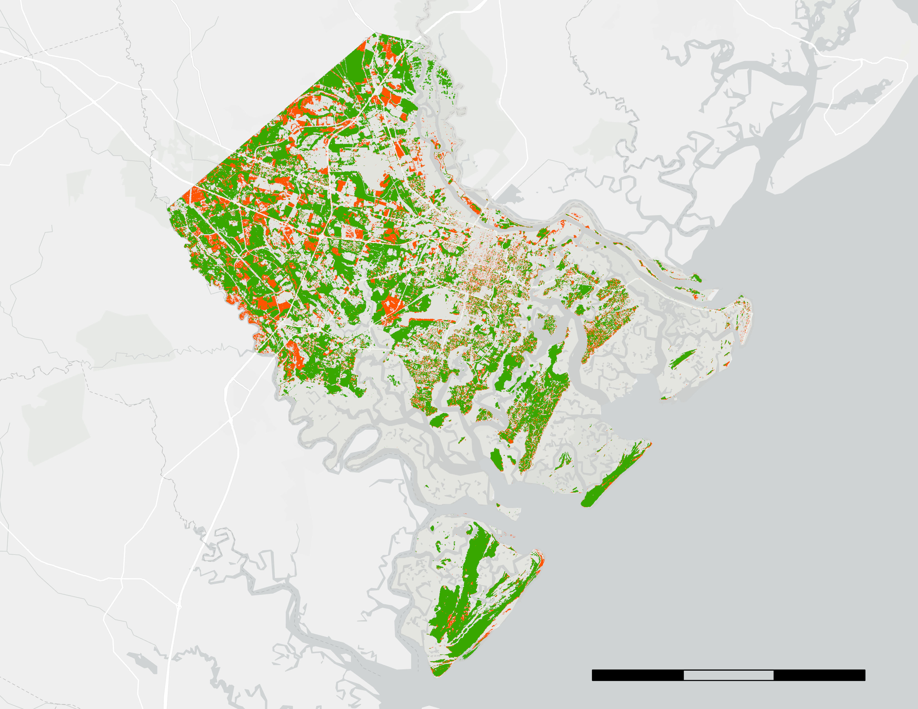


Results: 2014 – 2024 Canopy Cover Time Difference Map
Tree Canopy Cover Change
2014 – 2024
Remaining Canopy
Canopy Cover Change Over Time
Lost Canopy
2014 Canopy Cover: 31.80%
2024 Canopy Cover: 26.49%​
Between 2014 and 2024, Chatham County lost approximately 17% of its existing canopy cover.
0
5
mi
10
15
Basemap Credits: Esri, HERE, Garmin, INCREMENT P, © OpenStreetMap contributors, and the GIS User Community
Chatham County Health & Air Quality
2014 Canopy
2024 Canopy
Notes:
To showcase changes in tree canopy cover over the course of the study period, we created a time difference map of canopy cover change in Chatham County for the years 2014 and 2024. Canopy cover land classes were created using supervised classification of Landsat 8 imagery obtained through the USGS EarthExplorer data portal. Tree canopy cover for 2014 is represented with green, while the loss of tree canopy cover up to 2024 is represented in orange. Percentages of canopy cover are relative to the entire county area. Chatham County experienced a loss of almost 17 percent of its canopy cover between 2014 and 2024, which accounts for 6 percent of the total county area.

Slide 15
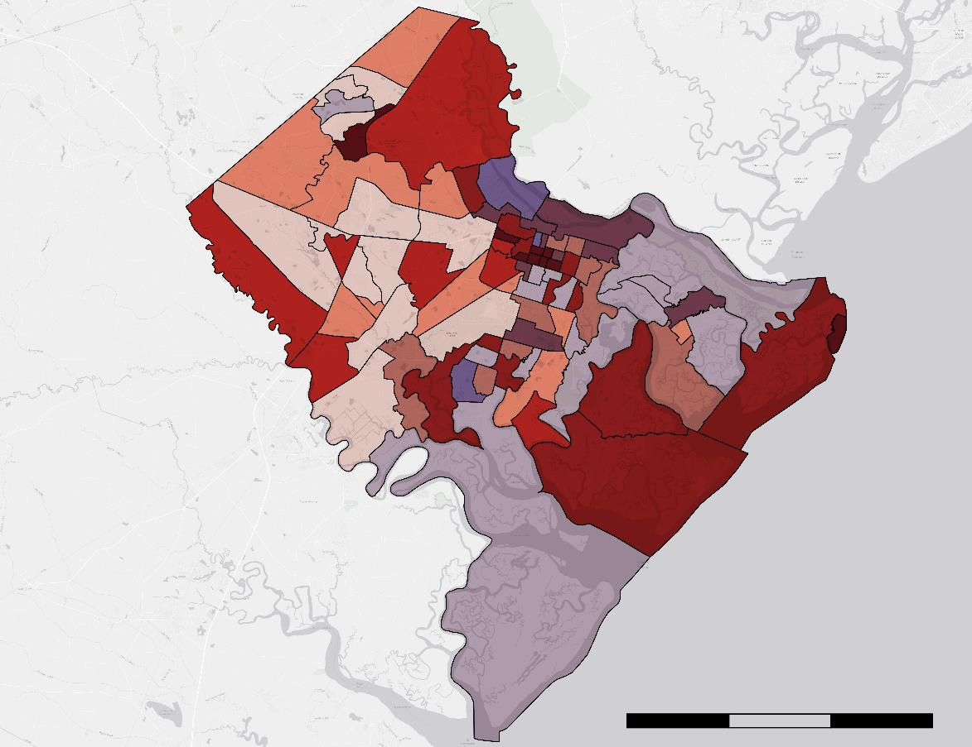

Results: Heat Vulnerability Index
Heat Vulnerability Index
2020 – 2022
Heat Vulnerability Index
High
Environmental Risk
Low
Low
High
Social Vulnerability
Census Group Boundaries
0
5
10
15 mi
Basemap Credits: Esri, HERE, Garmin, INCREMENT P, © OpenStreetMap contributors, and the GIS User Community
Chatham County Health & Air Quality
Notes:
Areas of high environmental risk and social vulnerability are shown in a dark maroon. Areas of high social vulnerability and low environmental are shown in red. Areas of high environmental risk and low social vulnerability are shown in dark purple. Areas of both low environmental risk and social vulnerability are shown in pink.
Analysis: Areas near the center of Savannah, as well as northern Pooler and Tybee Island display the greatest heat vulnerability indexed risk. This result displays our heat vulnerability index, which takes into account both environmental risk and social vulnerability factors to heat. Environmental risk consists of canopy cover, NDVI, and LST per census tract and social vulnerability consists of data pulled from the census community resilience estimate (CRE) for heat, which is a measure of social vulnerability as it relates to extreme heat exposure made up of 11 variables found to impact an individual/households resilience to heat, such as lack of air conditioning. Specifically, we mapped the "rate of individuals with three plus components of social vulnerability" and used quantiles to visualize this index.
Areas of high environmental risk and social vulnerability are shown in a dark maroon. Areas of high social vulnerability and low environmental are shown in red. Areas of high environmental risk and low social vulnerability are shown in dark purple. Areas of both low environmental risk and social vulnerability are shown in pink.
Analysis: Areas near the center of Savannah, as well as northern Pooler and Tybee Island display the greatest vulnerability to heat events.

Slide 16





























Methodology: Mitigation – InVEST Urban Cooling Model
Land Cover
Canopy Cover
Heat Mitigation Index
Image Credit: NaturalCapitalProject
Albedo
Image Credits: NASA
Evapotranspiration
Chatham County Health & Air Quality
Notes:
The InVEST Urban Cooling Model was developed by the Natural Capital Project and is used to estimate an index of heat mitigation using inputs including land cover, shade, albedo, and evapotranspiration. For 2021 (the most recent year of data available for all inputs), we obtained land cover and canopy cover (shade) from NLCD, albedo from Landsat 8 and 9, and evapotranspiration from ECOSTRESS. Albedo and Evapotranspiration were filtered for May-Oct while land cover and canopy cover were yearly datasets. Albedo and evapotranspiration were cloud-masked and composited, then summarized by land cover zones. Inputs were fed into the InVEST model software, which output a map displaying InVEST's heat mitigation index for May-Oct 2021. *TRANSITION BACK TO METHODS*: Another objective of our study was to get an understanding of heat mitigation within the county.
In order to do this we used the InVEST Urban Cooling Model
We obtained data from Landsat 8 and 9, and ECOSTRESS, to obtain land cover, canopy cover, albedo, and evapotranspiration data
These inputs were fed into the InVEST model software, which produced an index for heat mitigation
Extra Notes
Albedo and Evapotranspiration were filtered for May-Oct while land cover and canopy cover were yearly datasets. Albedo and evapotranspiration were cloud-masked and composited, then summarized by land cover zones.
2021 was the most recent year of data available for all inputs
----------Image Information Below----------
[Landsat 8]
Image Credit: NASA
Image Source: https://science.nasa.gov/multimedia/spacecraft-icons/%e2%80%8b
[Landsat 9]
Image Credit: NASA
Image Source: https://science.nasa.gov/multimedia/spacecraft-icons/%e2%80%8b
[ISS]
Image Credit: NASA
Image Source: https://science.nasa.gov/wp-content/uploads/2023/05/iss.png
[Earth Image] Image Source: https://images.nasa.gov/details/PIA18033
[InVEST Logo]
Image Credit: Natural Capital Project
Image Source: http://releases.naturalcapitalproject.org/invest-userguide/latest/en/index.html#
Image Credit: NASA

Slide 17
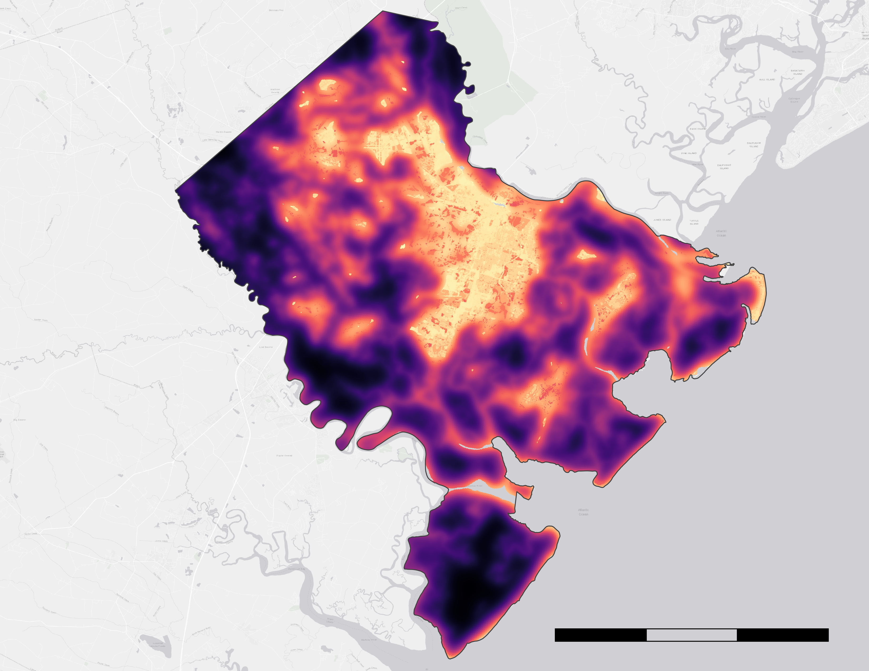

Results: Heat Mitigation Index
Heat Mitigation
2021
Heat Mitigation Index represents the ability of an area to cool itself
Low heat mitigation indicates an inability for an area to cool itself
High heat mitigation indicates that an area is effectively able to cool itself
High
Low
Chatham County
Boundary
0
5
10
15 mi
Basemap Credits: Esri, HERE, Garmin, INCREMENT P, © OpenStreetMap contributors, and the GIS User Community
Chatham County Health & Air Quality
Notes:
Speaker Notes
The heat mitigation index represents the ability of an area to cool itself
Here we have a map of the county, where areas of high heat mitigation are represented by dark purples while areas of low heat mitigation are represented by light yellows
Low heat mitigation indicates an inability to mitigate heat.
As expected, the areas with the lowest heat mitigation are in downtown Savannah, where greenery is low and the UHI effect is most pronounced.
Low heat mitigation is creeping into Garden City and Port Wentworth
Downtown Savannah is also vulnerable to environmental and social

Slide 18
Errors & Uncertainties
Data Acquisition
Data Processing​
Data Analysis​
Varying number of images per month & year​
Inconsistent spatial and temporal resolutions across datasets
Areas of null data due to cloud masking
Remotely sensed data and models have inherent accuracy
Marsh area NDVI results skewed by water amongst vegetation
Statistically insignificant number of images​
Comparing Urban Heat / NDVI at the beginning and end of period
InVEST outputs rely on empirical weights of high uncertainty and do not consider meteorological effects
Chatham County Health & Air Quality
Notes:
When gathering images to make urban heat NDVI composites, we encountered varying numbers of usable images, and not enough to have a statistically significant composite for a single year. To mitigate this, we made image composites for every two years so as to have enough sample images. Additionally, we encountered inconsistencies with data spatial and temporal resolutions that needed to be worked through. Similarly, many of the data sources we used for the InVEST model had temporal restriction such as the community resilience estimates, which were only taken between 2020 and 2022
During Data processing, we found that cloud masking resulted in some areas having no data. This occurred at locations where all of the pixels contributing to the composite area are contaminated with excess cloud cover. Additionally, the process we used for sampling the Landsat 8 imagery for classifying tree canopy is done using a sample of pixels and is nearly impossible to perform with 100% accuracy.
During our analysis, we used urban heat and NDVI image compilations that did not incorporate 30 images. This means that these compilations by definition do not have enough images to statistically validate the trends we are seeing. Additionally, by comparing urban heat and NDVI changes at the beginning and end of our study period, we exclude any variability that occurred between 2014 and 2024. Finally, the InVEST model as different sources of uncertainty stemming from the analysis step, including outputs relying on empirical weights that are themselves highly uncertain, and regional wind patterns not considered as a cooling agent.
Data Acquisition
There were varying numbers of images for different months and years
Datasets have inconsistent spatial and temporal resolutions
InVEST (2021)
Community Resilience Estimates (2020-2022)
Data Processing:
Cloud-masking resulted in some areas having no data
Satellite imagery has inherent error
The presence of water among vegetation in marsh areas skews NDVI results
Data Analysis:
Statistical significance was not achieved for canopy cover analysis (< 30 images)
In order to reach statistical significance, Images across multiple years were needed for urban heat and NDVI
We exclude any variability that occurred between the beginning and end of the study period.
The InVEST model uses a formula with uncertain empirical weights
The InVEST model does not take into account dynamic meteorological effects (such as wind) when calculating heat mitigation index

Slide 19

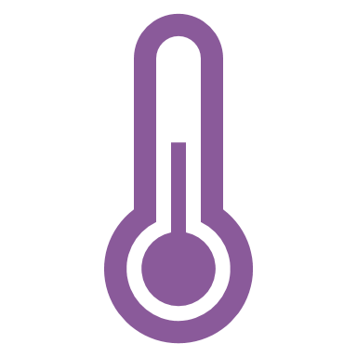
Feasibility & Partner Implementation
Used to visualize environmental factors contributing to urban heat throughout Chatham County
NASA Earth
Observations
can be:
Paired with social vulnerability information to map heat vulnerability
Heat vulnerability and mitigation maps can inform where both new tree planting and cooling station projects will be most impactful
Chatham County Health & Air Quality
Notes:
Our team was able to use NASA earth observations to map heat-related environmental factors that contribute to the urban heat island affect in chatham county
Additionally, we were able to pair these environmental factors with social vulnerability data to identify areas in the community most susceptible to heat impacts
This information can be used by Chatham county to help move heat related policy initiatives forward and inform the public about changes in the county's ambient heat trends
In spite of some errors and uncertainties, our team found that it is feasible to use earth observations to map heat-related environmental factors that contribute to the UHI effect in Chatham County
We were able to pair environmental data and social vulnerability data to identify areas in the community that are most susceptible to heat impacts
Our analyses can be used by the county to help push forward heat-related policies and inform Chatham county citizens about local heat trends

Slide 20
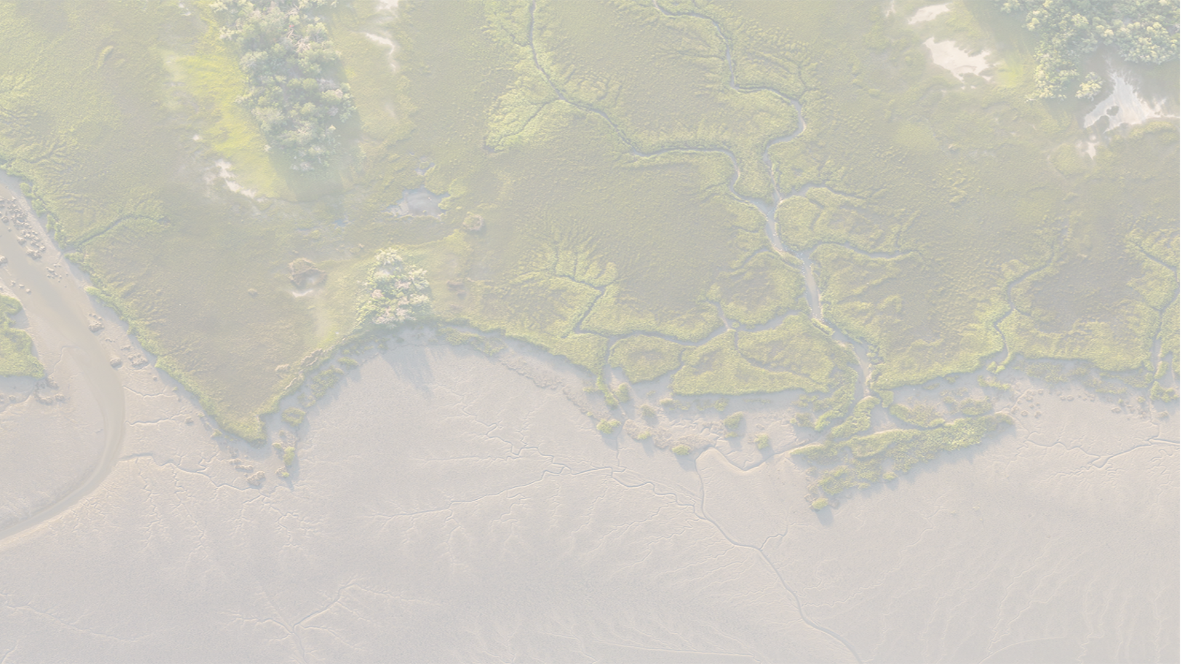
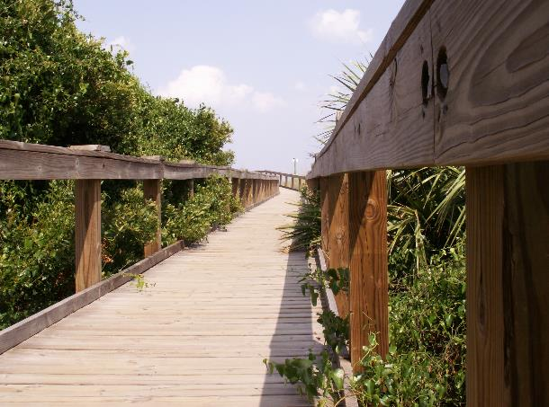

Conclusions
Heat mitigation is lower in dense urban areas such as downtown Savannah
Areas of low vegetation health/density and high urban heat expanded in the North-Western part of the county between 2014 and 2024
Decreases in vegetation health are moderately correlated to increases in urban heat
Canopy cover decreased by 17 percent between 2014 and 2024
Image and Background Credits: Chatham County​​
Chatham County Health & Air Quality
Notes:
We found that areas with low vegetation health and high urban heat expanded predominantly in the northwestern part of the county during our study period.
We also found that vegetation health and urban heat are moderately negatively correlated with each other when we looked specifically within pooler and port wentworth.
We also found that during our study period that canopy cover within the county decreased by 17% within the study period
We found that heat mitigation is lowest in dense urban areas and is highest in more rural areas

Slide 21
We would like to thank our Science Advisors and Center Leads for their continuous support and guidance throughout the term:
We would also like to thank our project partners and collaborators, your support helped make this project possible:
Dr. Xia Cai (NASA Langley Research Center)
Dr. Kenton Ross (NASA Langley Research Center)
Conor Doherty (Ames Research Center)
Katie Miller (California – Ames)
Maya Hall (California – Ames)
Caroline Baumann (California – JPL)
Brent Bowler (Viginia – Langley)
Jackie Jackson (Chatham County)​
Matt Gerig (Chatham County)​
Randal Mathews (Chatham County)
Anthony Giarrusso (Georgia Tech)​
Zoe Rinker (Savannah Tree Foundation)​
Kait Morano (Georgia Tech)​
David Donnelly (City of Savannah)
Chris Rustin (State of Georgia)
Notes:
We want to thank everyone who helped make this project possible (read off names)

Slide 22
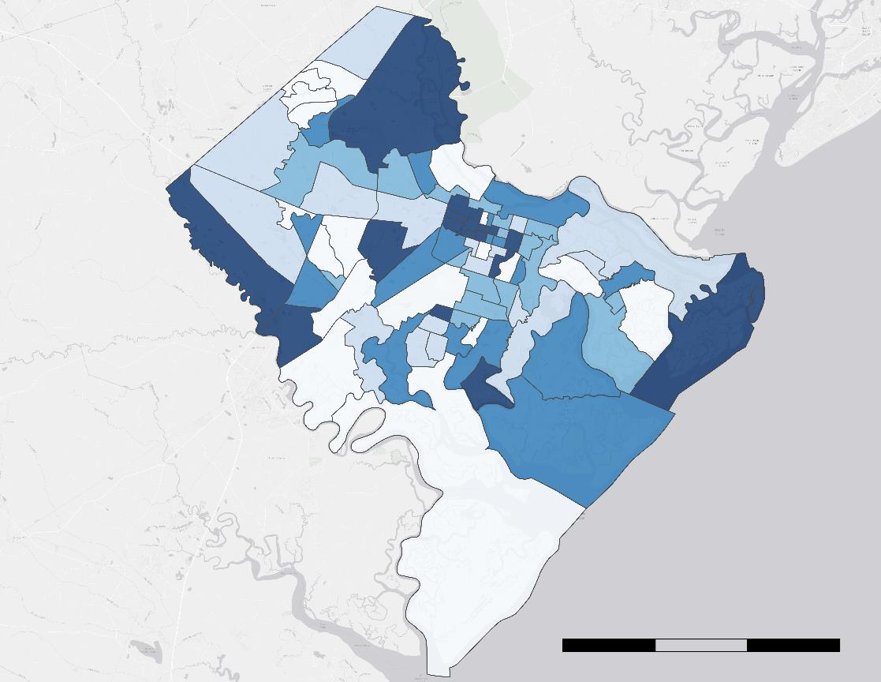
Social Vulnerability Index
Social Vulnerability Index
Social Vulnerability Index
0 - 17
17 - 21
21- 26
26 - 33
36 - 49
Index composed of factors determined by the U.S. Census Bureau to be associated with vulnerability to heat events
0
5
10
15 mi
Basemap Credits: Esri, HERE, Garmin, INCREMENT P, © OpenStreetMap contributors, and the GIS User Community
Chatham County Health & Air Quality
Notes:
This social vulnerability consists of data pulled from the census community resilience estimate (CRE) for heat, which is a measure of social vulnerability as it relates to extreme heat exposure. Specifically, we mapped the "rate of individuals with three plus components of social vulnerability" and used quantiles to visualize this index. Light blue indicates low social vulnerability whereas dark blue indicates high social vulnerability. As you can see, the center of Savannah as well as some census tracts in the Northern and Southern parts of the county are most vulnerable.

Slide 23
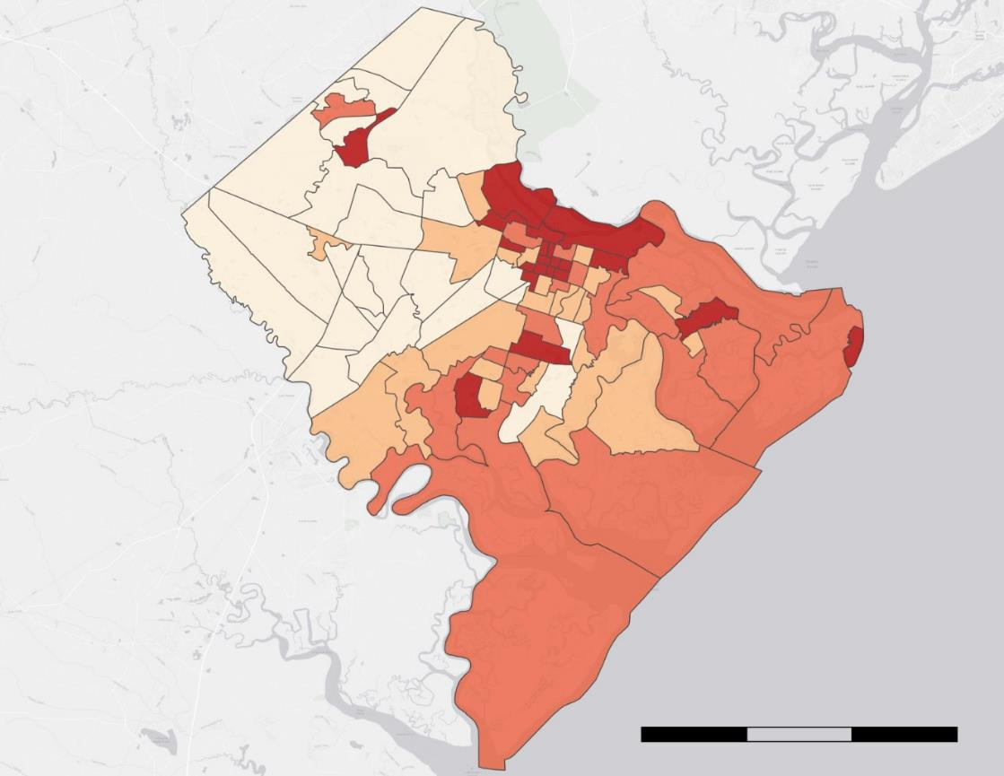
Environmental Risk Index
Environmental Risk Index
Environmental Risk Index
3 - 4
4 - 6
6 - 7
7 - 9
ERI Components
Canopy Cover
LST
NDVI
0
5
10
15 mi
Basemap Credits: Esri, HERE, Garmin, INCREMENT P, © OpenStreetMap contributors, and the GIS User Community
Chatham County Health & Air Quality
Notes:
This environmental risk index, as it pertains to urban heat, is composed of three variables: canopy cover percentage per census tract, median LST per census tract, and median NDVI per census tract. Dark red indicates high environmental risk whereas beige indicates low environmental risk.
Areas of high environmental risk are concentrated in the center of Savannah, meaning these areas are more at risk to extreme heat.

Slide 24
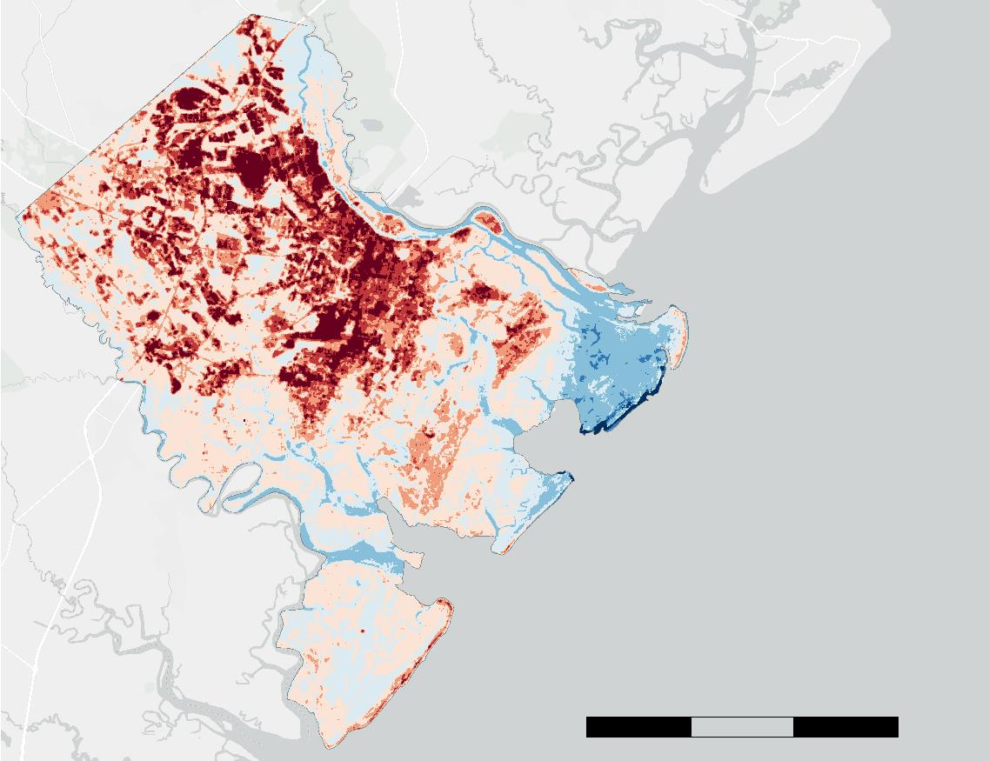
Urban Heat: 2022 – 2024
Median Urban
Heat (°F)
< -15°
-15° - -10°
-10° - -5°
-5° - 0°
0° - 5°
5° - 10°
10° - 15°
N
>15°
0
5
10
15 mi
Chatham County Health & Air Quality
Notes:
This map presents composite urban heat between 2022 and 2024. Median urban heat was found to be the highest in more urbanized areas such as downtown savannah, garden city, and up through both pooler and port wentworth.

Slide 25
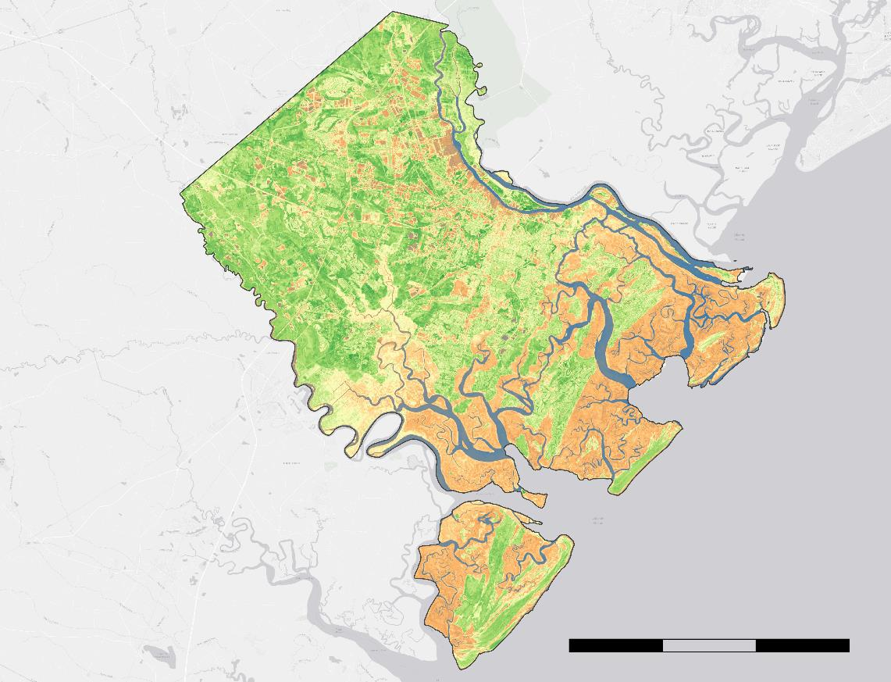

Vegetation Health 2022 – 2024
Vegetation Health
2022 – 2024
Vegetation Health
0.5 (Healthy Vegetation)
0 (Low Vegetation Health)
-0.05 (Water)
Chatham County Boundary
0
5
10
15 mi
Basemap Credits: Esri, HERE, Garmin, INCREMENT P, © OpenStreetMap contributors, and the GIS User Community
Chatham County Health & Air Quality
Notes:
This map shows the recent state of vegetation health and density in the county, using data from 2022 to 2024. Bright green is indicative of healthy vegetation, orange is indicative of low vegetation health, and blue is indicative of water. The urban centers as well as suburbs in the North-West of the county show the lowest vegetation health, along with marsh areas which have NDVI values skewed by water amongst vegetation.

Slide 26
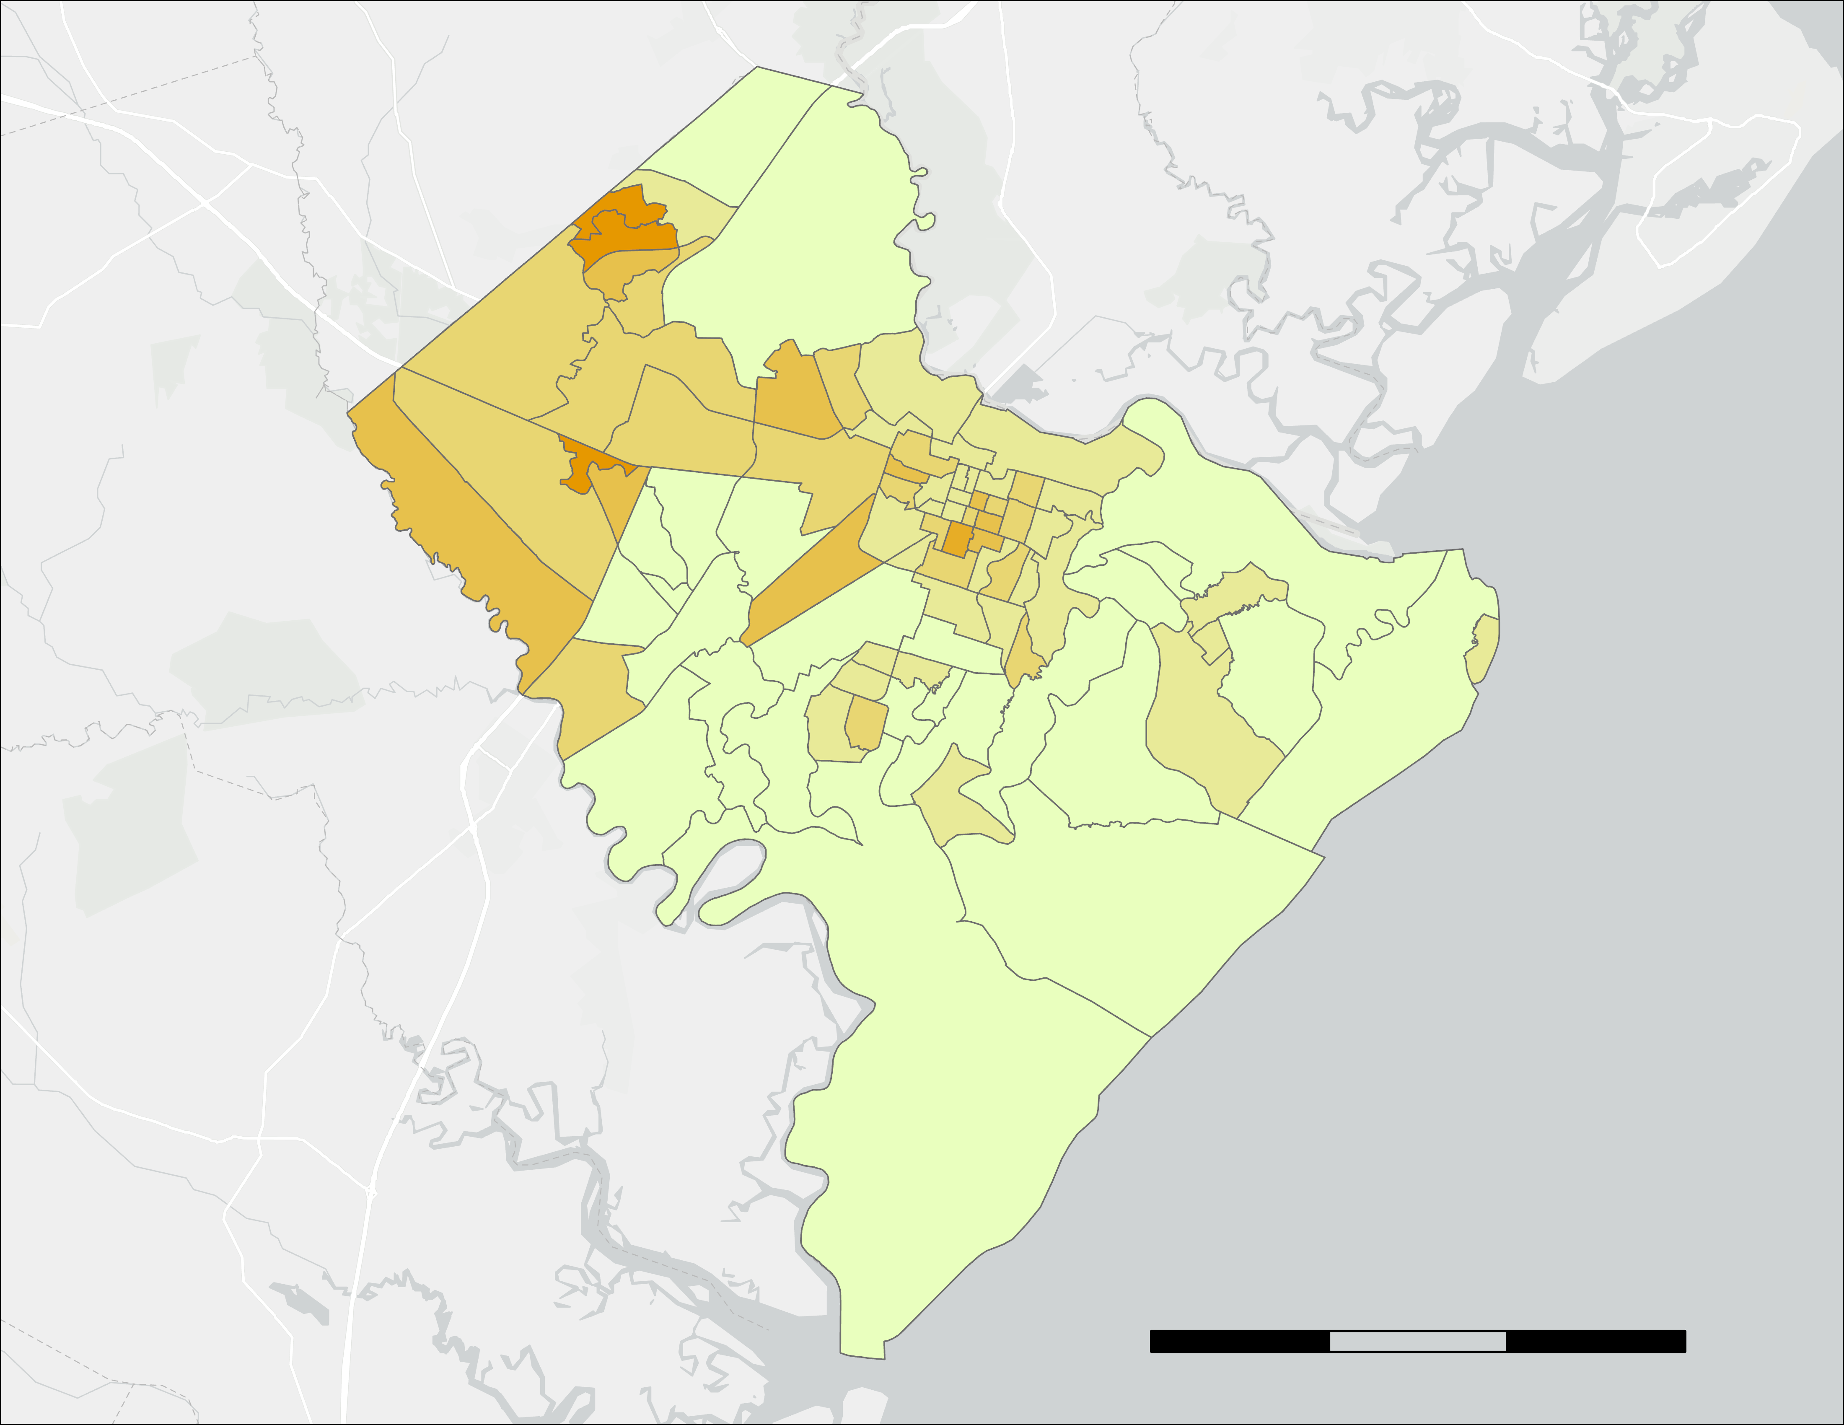
Results: 2014 – 2024 Canopy Cover Loss Map
Tree Canopy Cover Loss
2014 – 2024
Canopy Cover Loss
(2014 – 2024)
>25%
20-25%
15-20%
10-15%
5-10%
0-5%
0
5
mi
10
15
Basemap Credits: Esri, HERE, Garmin, INCREMENT P, © OpenStreetMap contributors, and the GIS User Community
Chatham County Health & Air Quality
Notes:
Further data analysis of Tree canopy cover was performed by comparing percentage of canopy cover loss per census tract within the county. All tracts within Chatham have lost tree canopy over the ten-year study period, with the most severe losses in canopy being located in more northern areas where industrialization has been occurring.

